Slide 1

House Location
Prediction
Using Machine Learning
Presented by Group 3
21st February, 2025

Slide 2

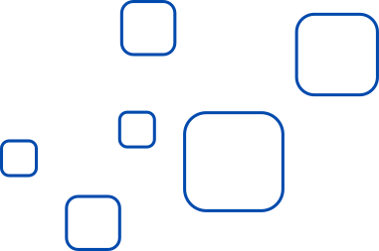



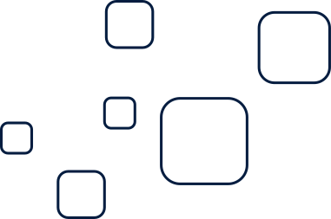
PROBLEM STATEMENT
House hunting can be overwhelming—too many options, unclear pricing, and no easy way to find the best location within budget.
This project uses machine learning to predict the best town for a house based on budget, property type, and key features.
House Location Prediction I Presented by Group 3

Slide 3
Classification Problem
This is a classification problem as we are predicting a categorical outcome (Town) based on numerical and categorical features.
House Location Prediction I Presented by Group 3

Slide 4

DATASET & FEATURES
Data Source: Kaggle.com
Feature Variables
Target Variable
Price
Number of bedrooms
Number of bathrooms
Number of toilets
Parking space
Title (property type)
State
Town
House Location Prediction I Presented by Group 3

Slide 5

Data Cleaning and Preprocessing
The strategic process
Checked for missing values and found that there were no missing values
House Location Prediction I Presented by Group 3

Slide 6
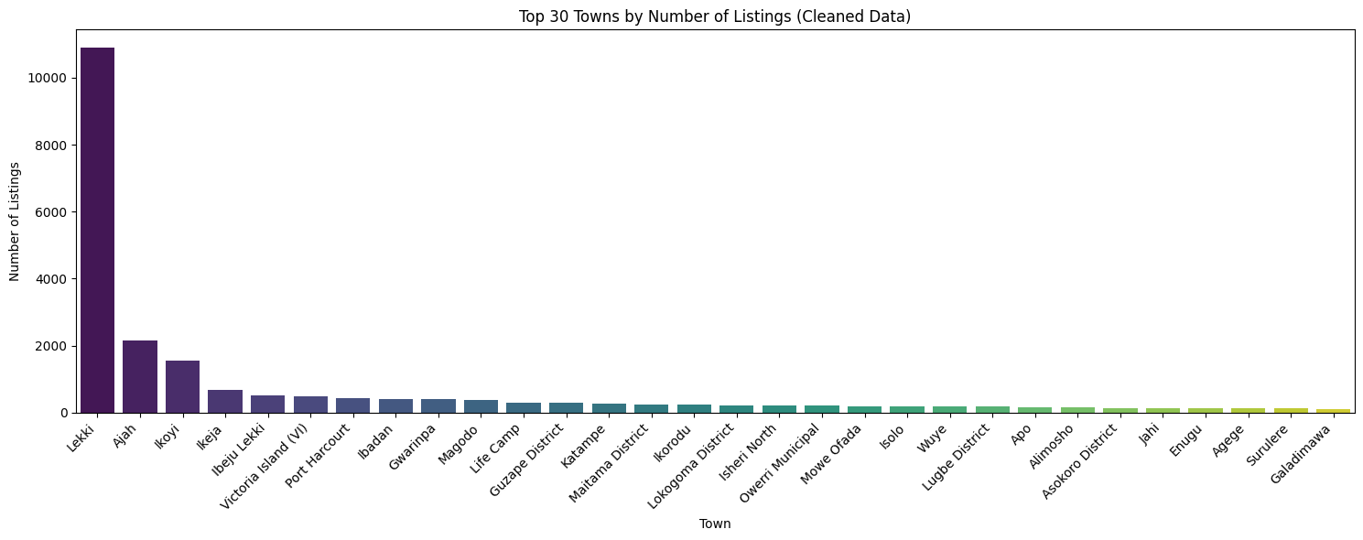
Data Visualization
Distribution of listings across towns (Top 30)
Observations
Lekki has the highest number of listings, far more than other towns.
Ajah, Ikoyi, and Ikeja follow but with significantly fewer listings.
The distribution is highly imbalanced, with most listings concentrated in a few towns.
Smaller towns have very few listings, which may affect model accuracy.

Slide 7
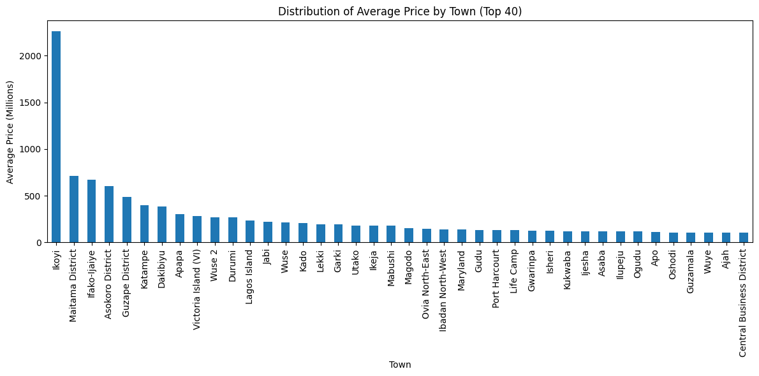
Data Visualization (cont.....)
Average Price Distribution by Town
Observations
House prices vary significantly across towns.
Lekki and Victoria Island have some of the highest average prices.

Slide 8


Our observations after EDA
Town Distribution:
Numerical Features:
The cleaned data still shows an imbalance in the number of listings across towns, which may affect our model's performance.
The descriptive statistics confirm that price values are in millions, ranging from ₦0.09 million to ₦322 million. Other features like bedrooms, bathrooms and toilets have consistent ranges without extreme outliers.
Remedy
To remedy for the imbalances observed in our town distribution, we created a boolean mask where prices of houses in the various towns is between the 15th and 85th percentiles.

Slide 9
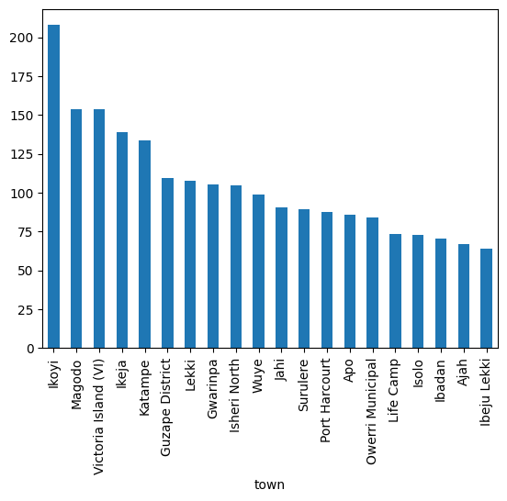
Result
House Location Prediction I Presented by Group 3

Slide 10

Model Selection & Training
Data were splitted into training (70%) and testing (30%) sets.
Random Forest Classifier Model
Logistic classifier Mode
Random Forest Model trained with 100 estimators
Achieved 71% accuracy
Model performed well for frequent towns but struggled with less common ones.
Achieved 70% accuracy, slightly lower than Random Forest.
Struggled with imbalanced data, leading to lower recall for some towns.
Support Vector Machine (SVM) Model
K-Nearest Neighbors model
Accuracy 69 % : Slightly lower than Random Forest
Performed well on highly populated towns but poorly on rare cases.
Struggled with classification due to distance-based approach.
Accuracy 69 % : lower than Random Forest.

Slide 11


Hyperparameter Tuning
71%
Increased estimators from 100 to 500 in Random Forest.
Slight improvement but thesame accuracy and increased computation time.

Slide 12
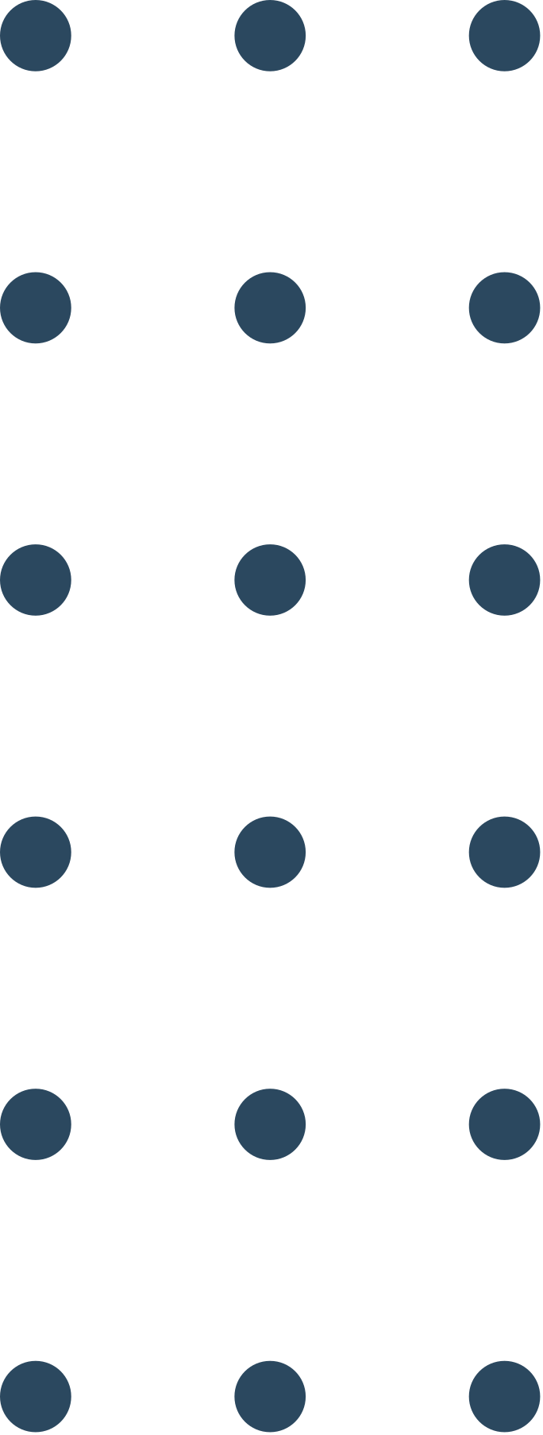

Conclusion & Recommendations
Random Forest was the best-performing model
Challenges faced:
Some towns had too few listings for reliable predictions.
Future Work:
Collect more data to balance town distributions.
Add State as a target variable alongside Town
Experiment with deep learning for improved performance

Slide 13



THANK YOU!
www.reallygreatsite.com

